Slide 1
Aims:
SWBAT learn about world water crises, in order to create a global outlook on water quality
Do Now:
1) How many gallons of water does your family use a week to shower? (Average American shower uses 17.2 gal/8 min)
2) Do you think this is a little, or a lot?

Slide 2
Directions
For each slide, write down either what you’ve learned from the slide or any response you have to the slide.

Slide 3
#1

Slide 4
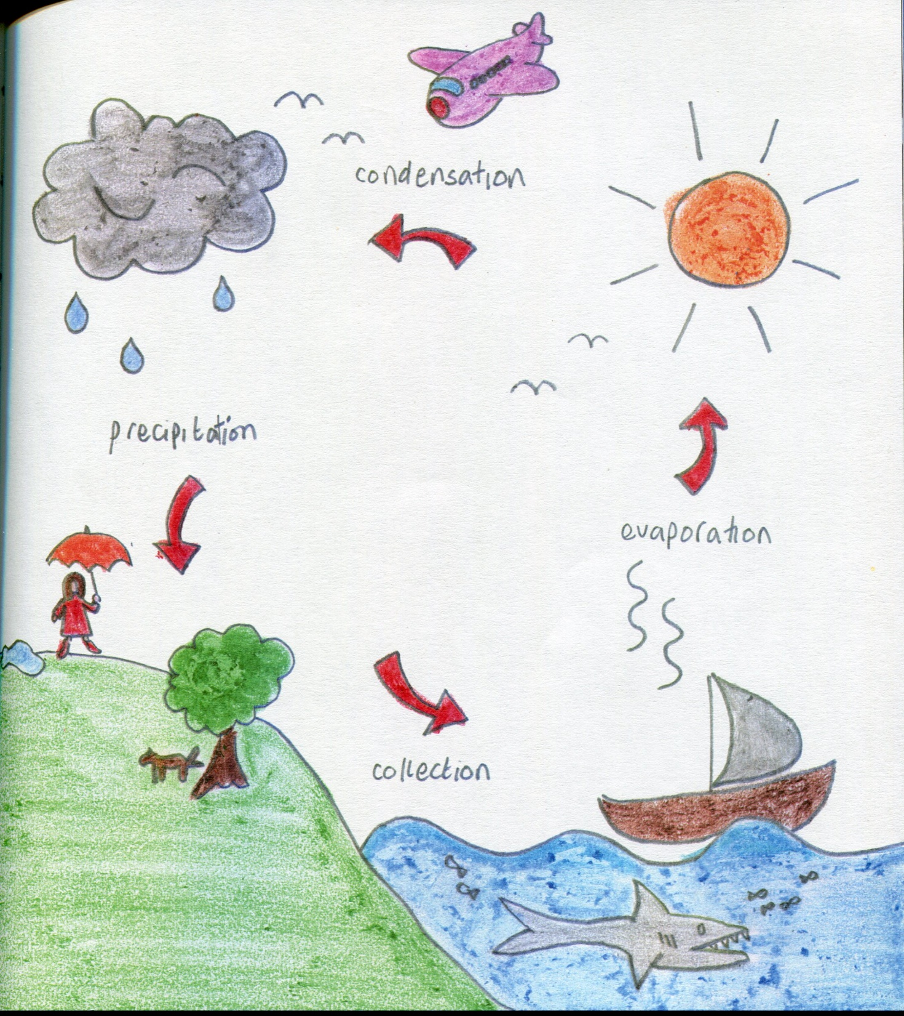
#2

Slide 5
#3

Slide 6
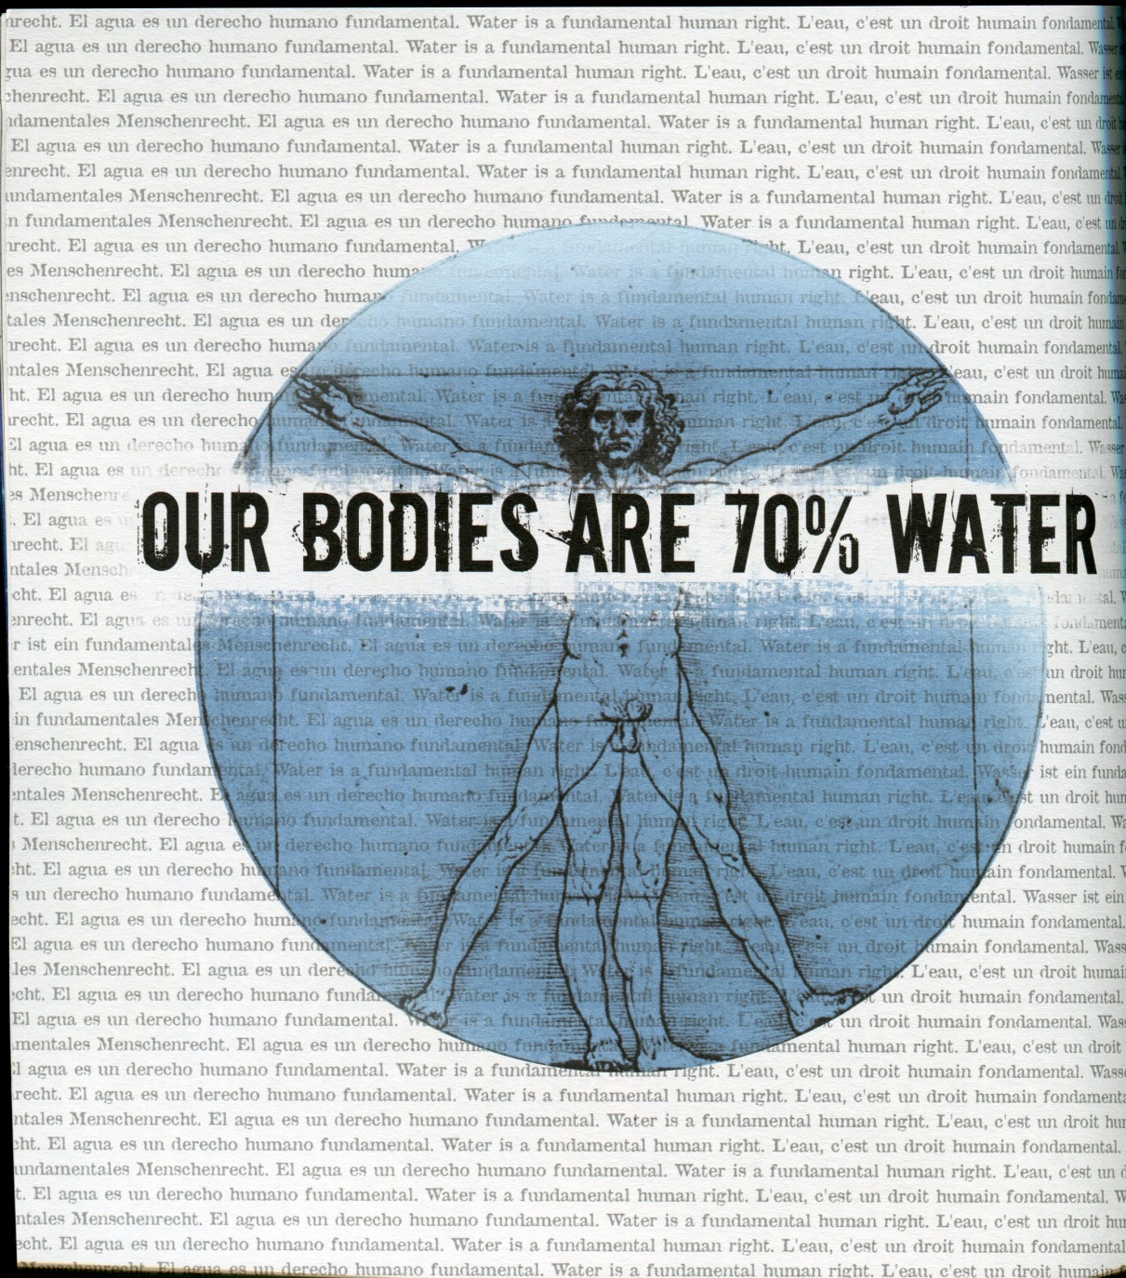
#4

Slide 7
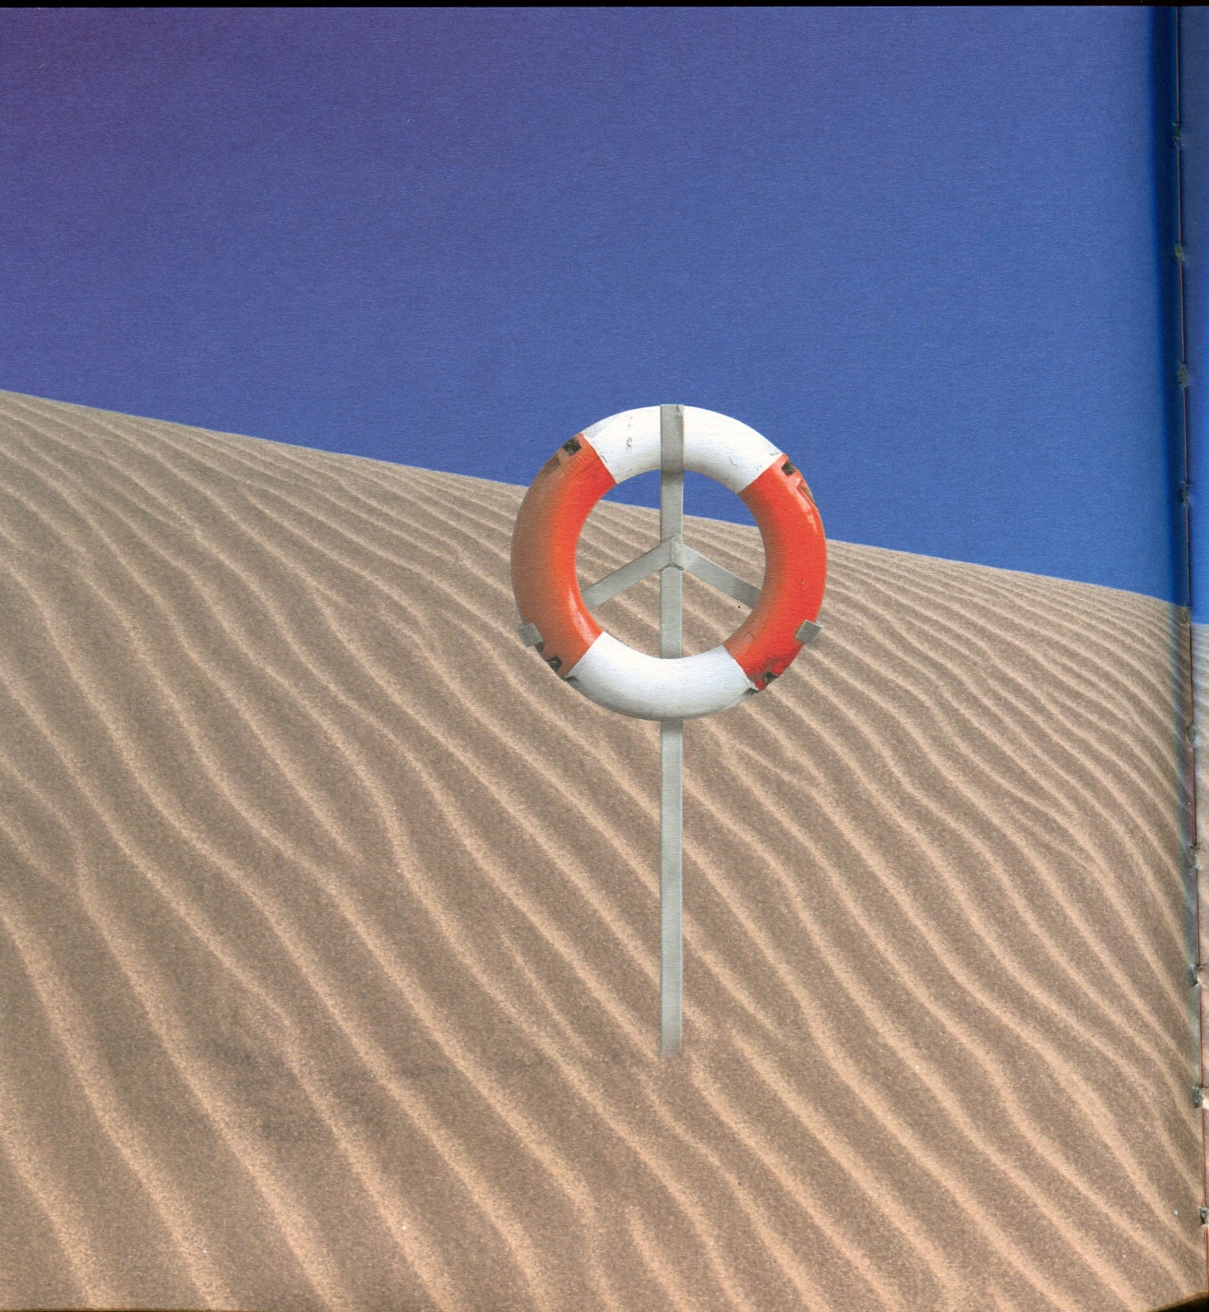
#5

Slide 8
#6

Slide 9
#7

Slide 10
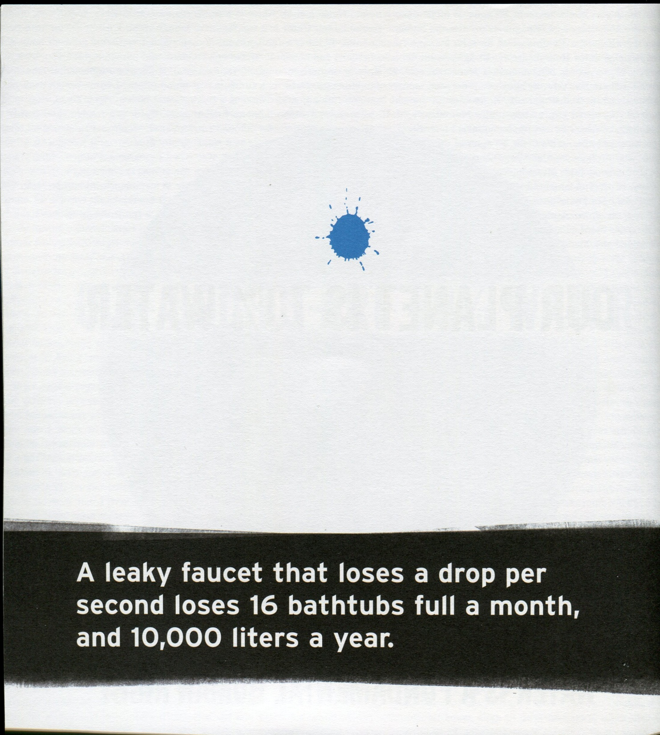
#8

Slide 11
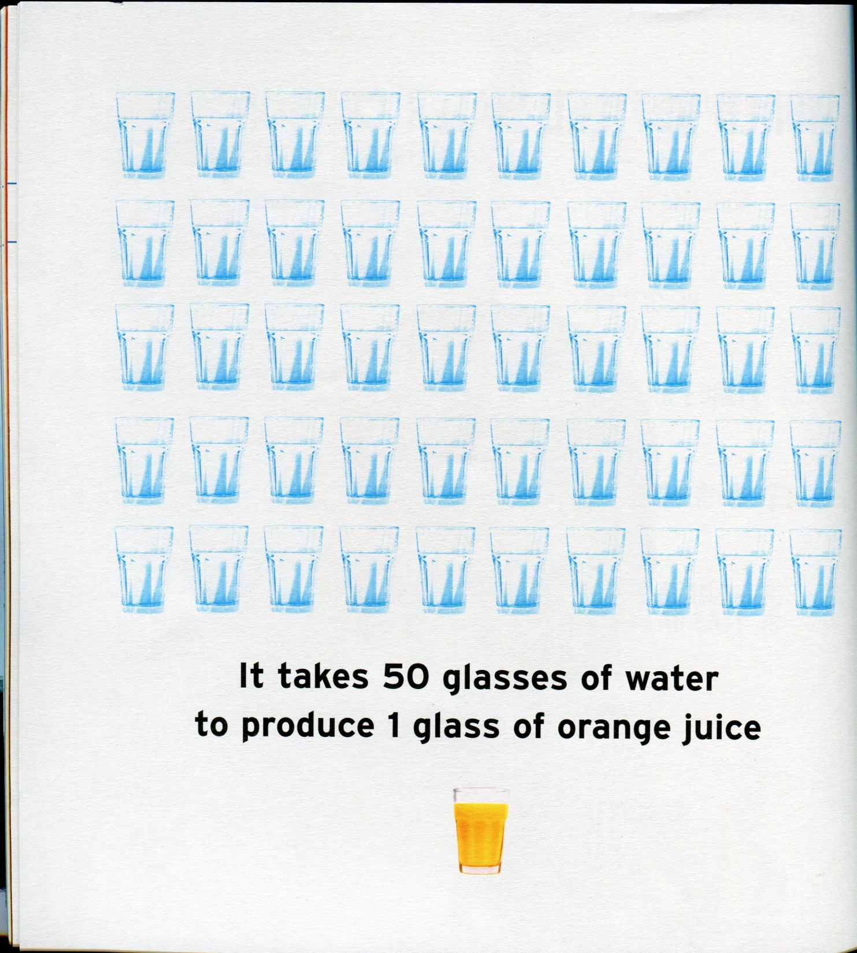
#9

Slide 12
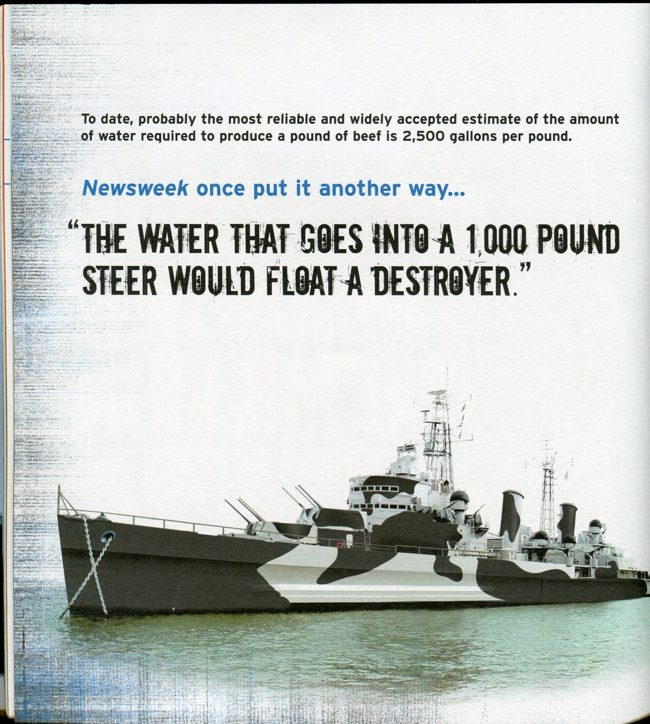
#10

Slide 13
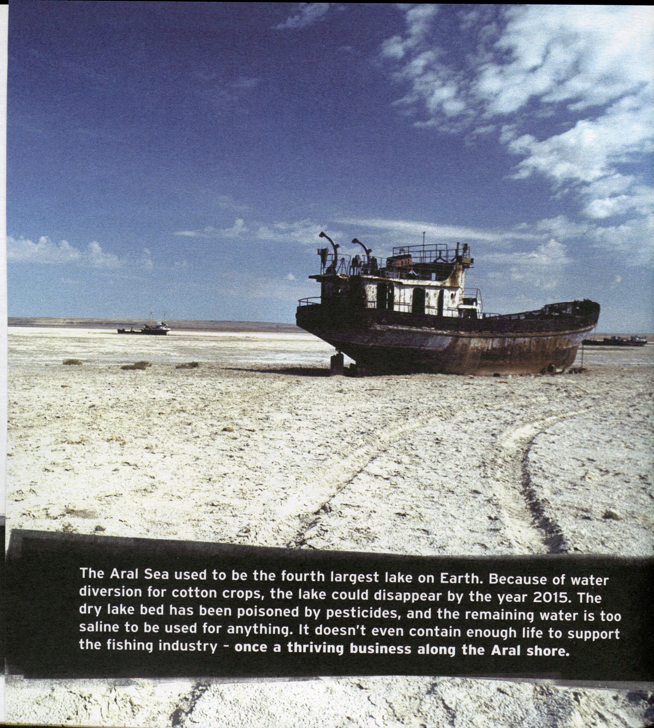
#11

Slide 14
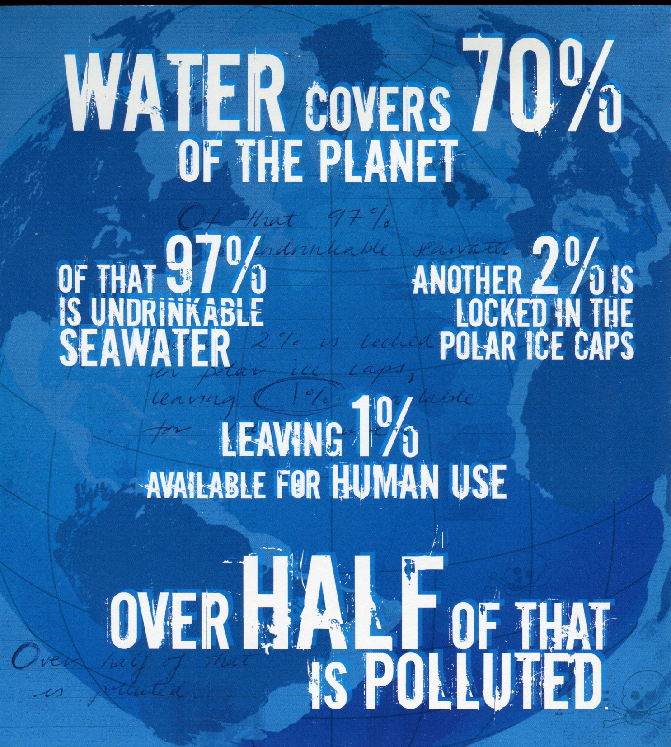
#12

Slide 15
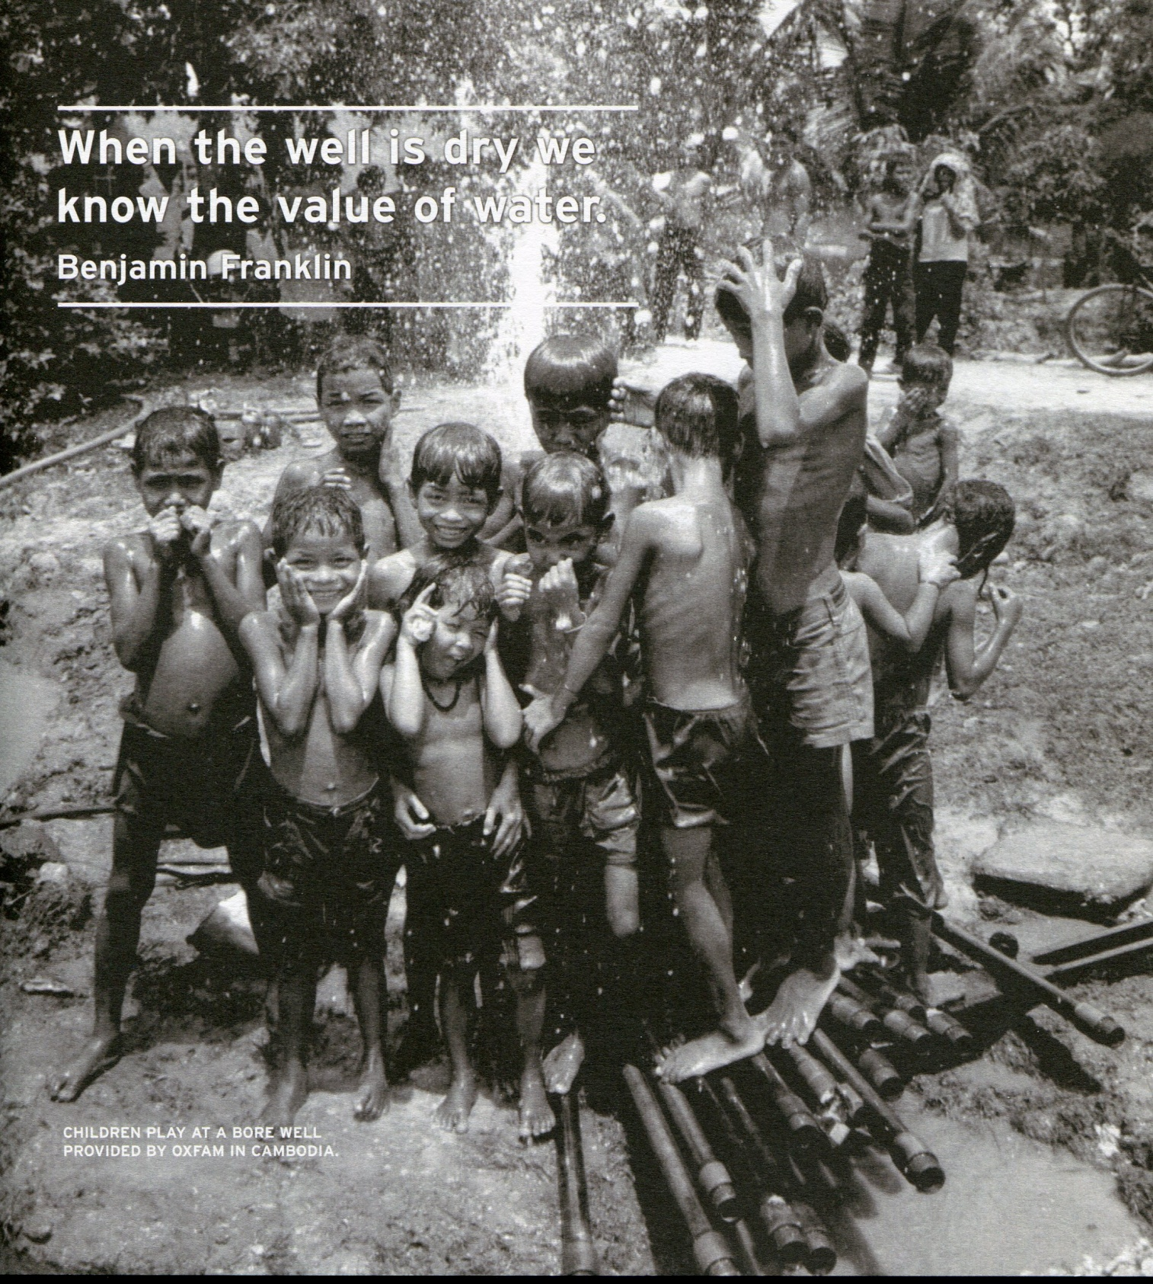
#13

Slide 16
#14

Slide 17
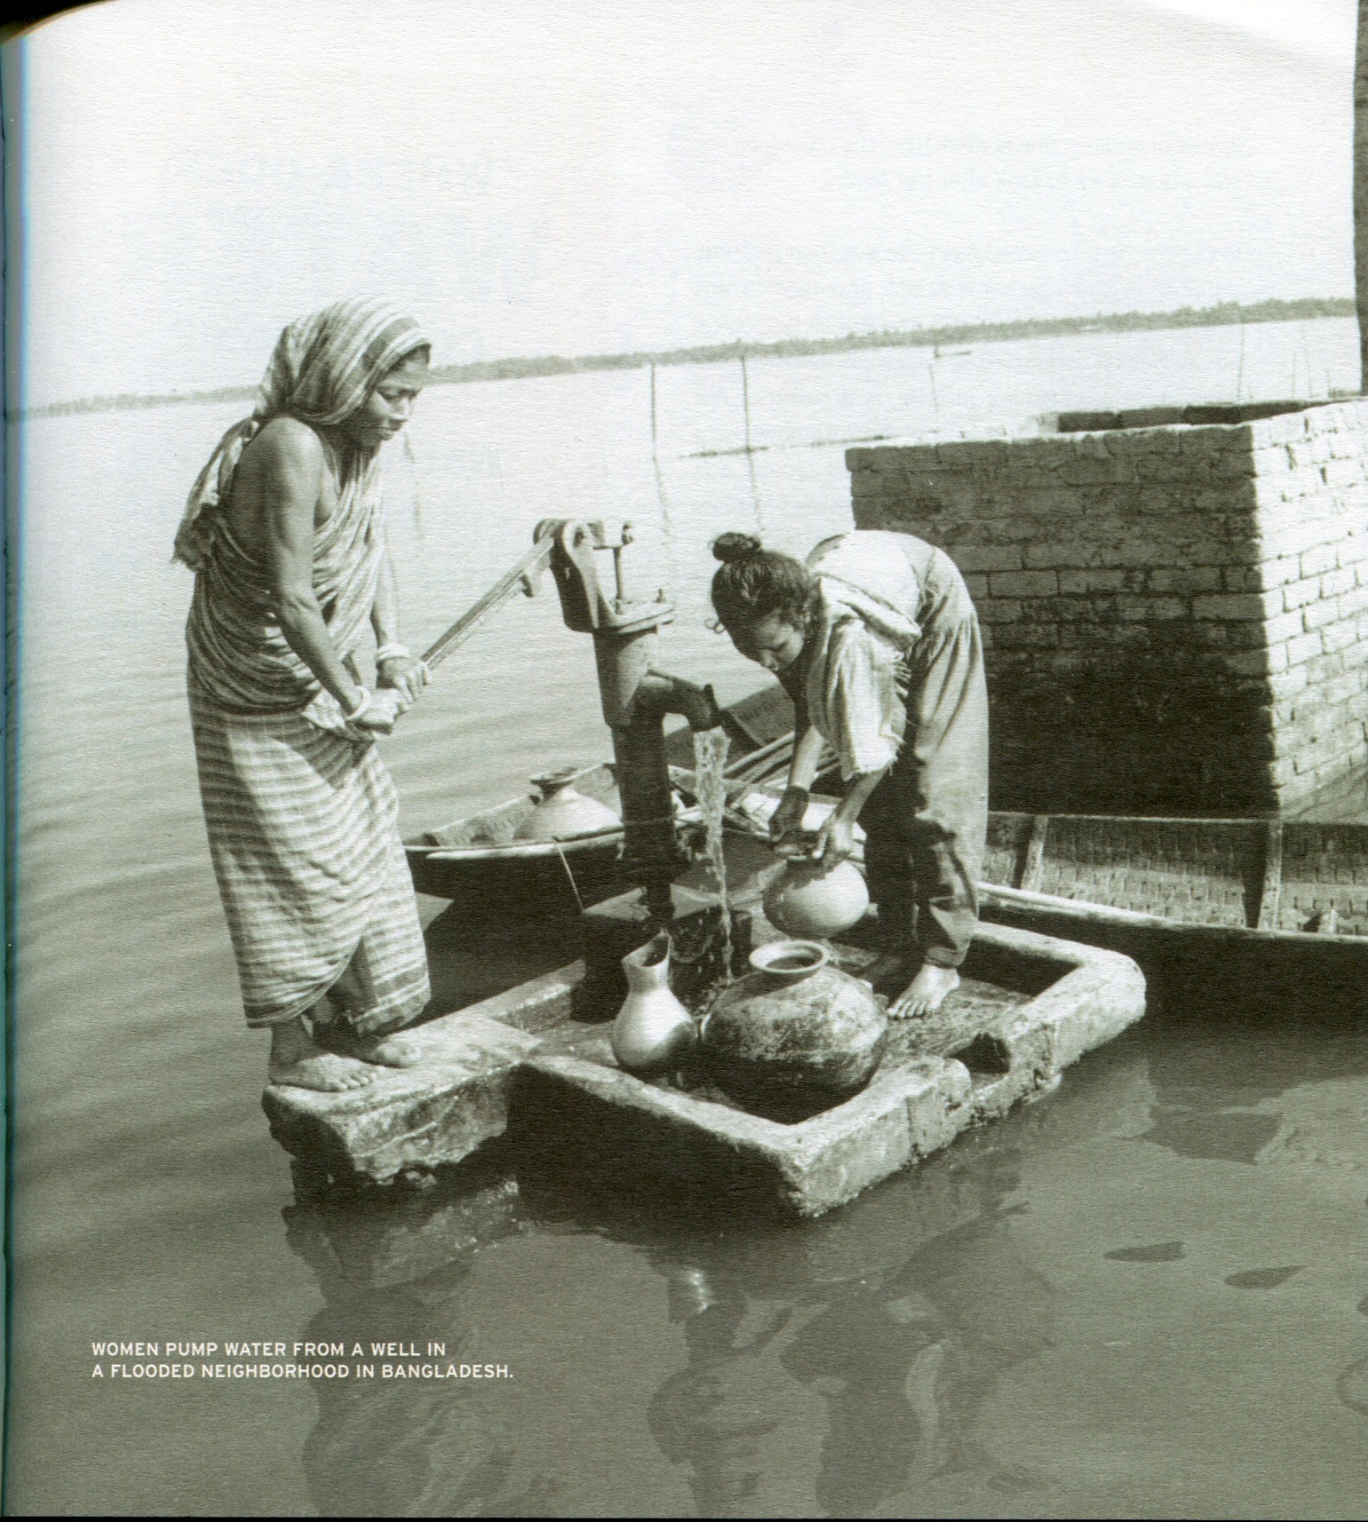
#15

Slide 18
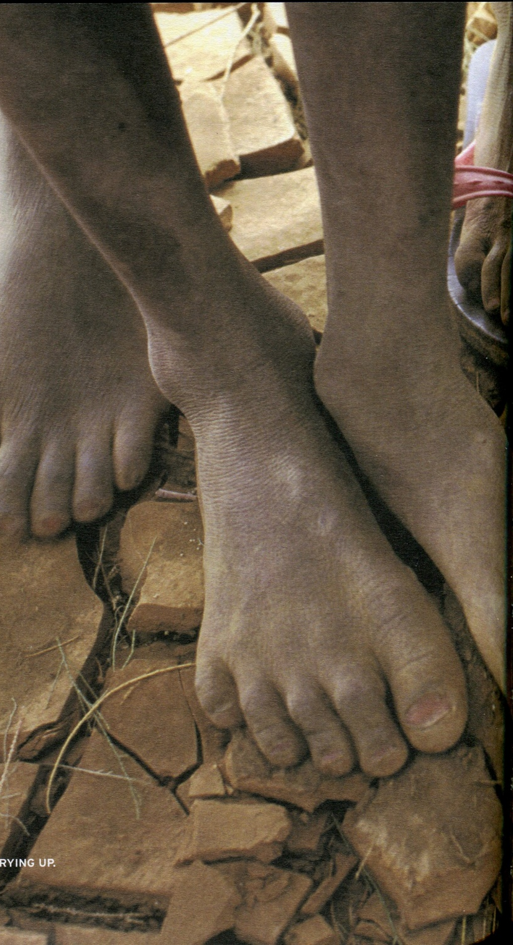
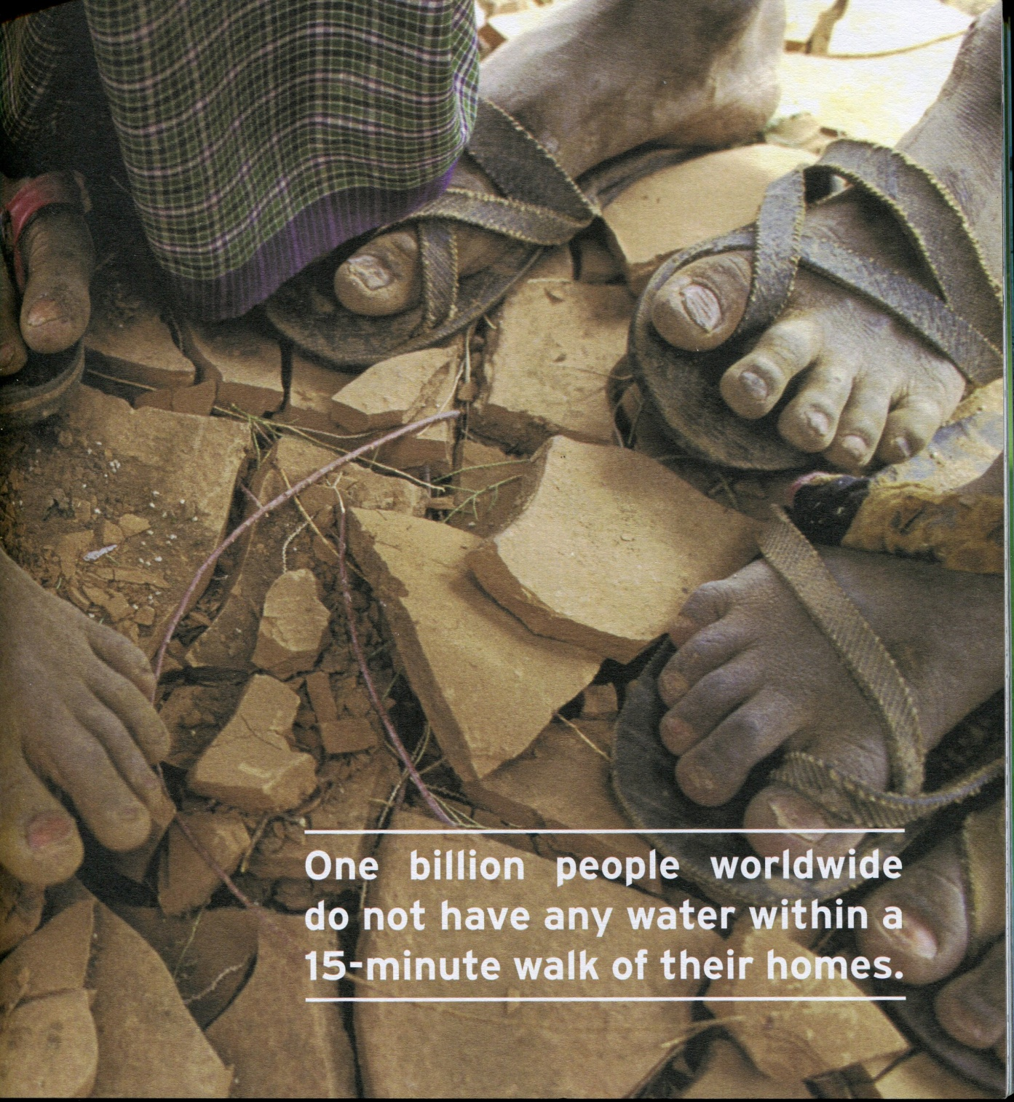
#16

Slide 19
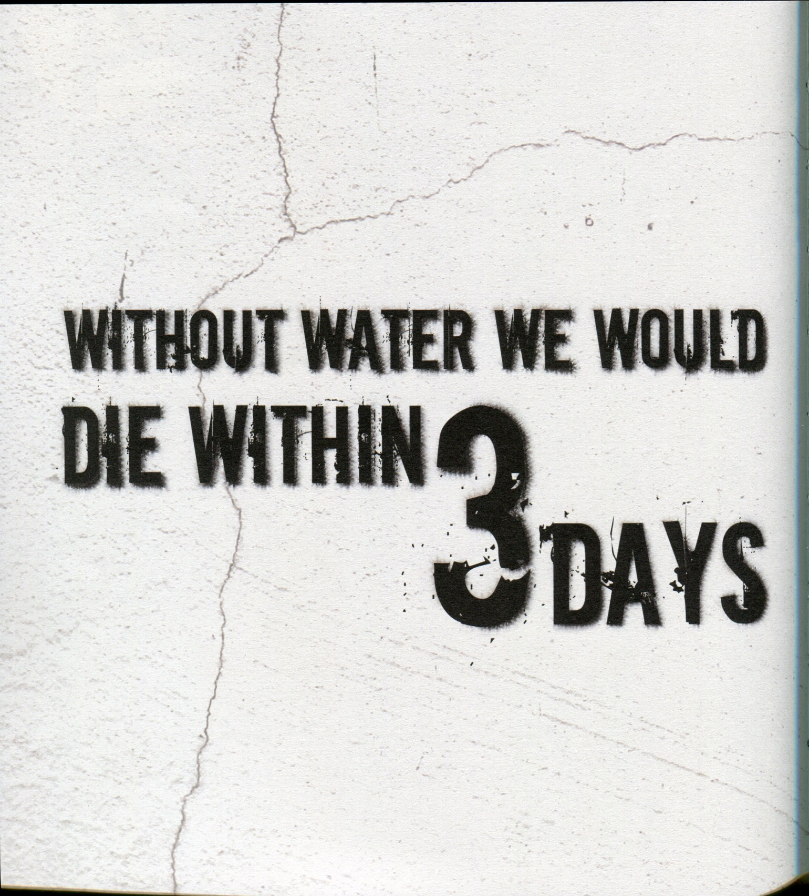
#17

Slide 20
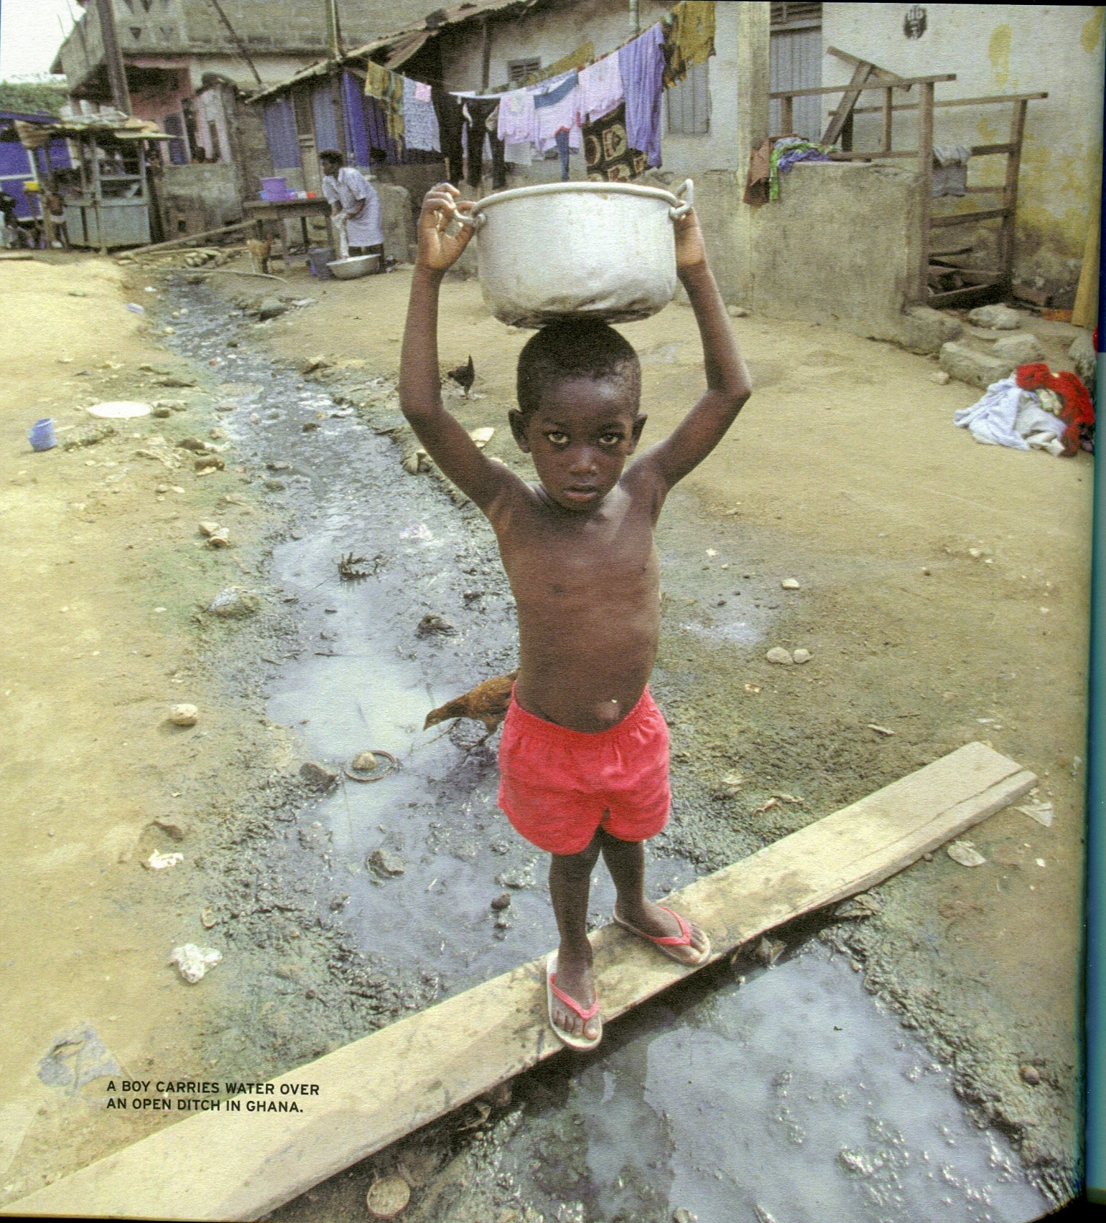
#18

Slide 21
#19

Slide 22
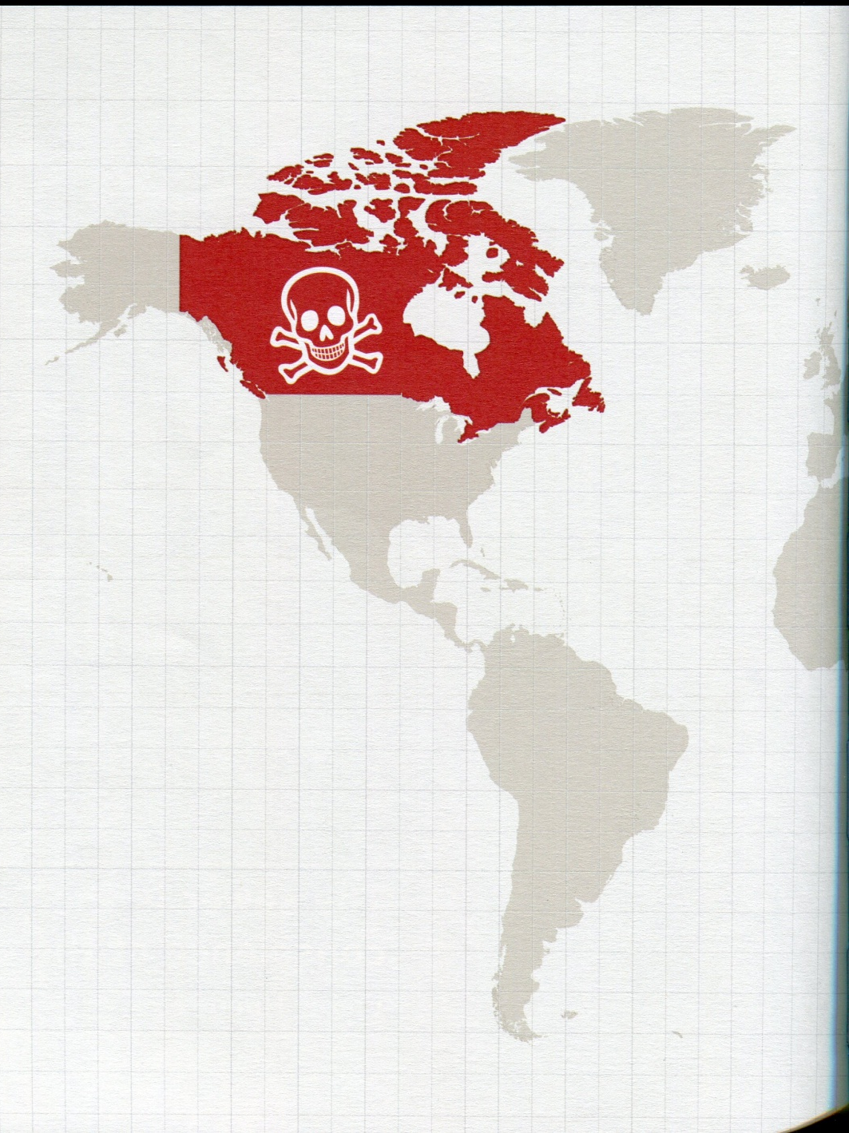
#20

Slide 23
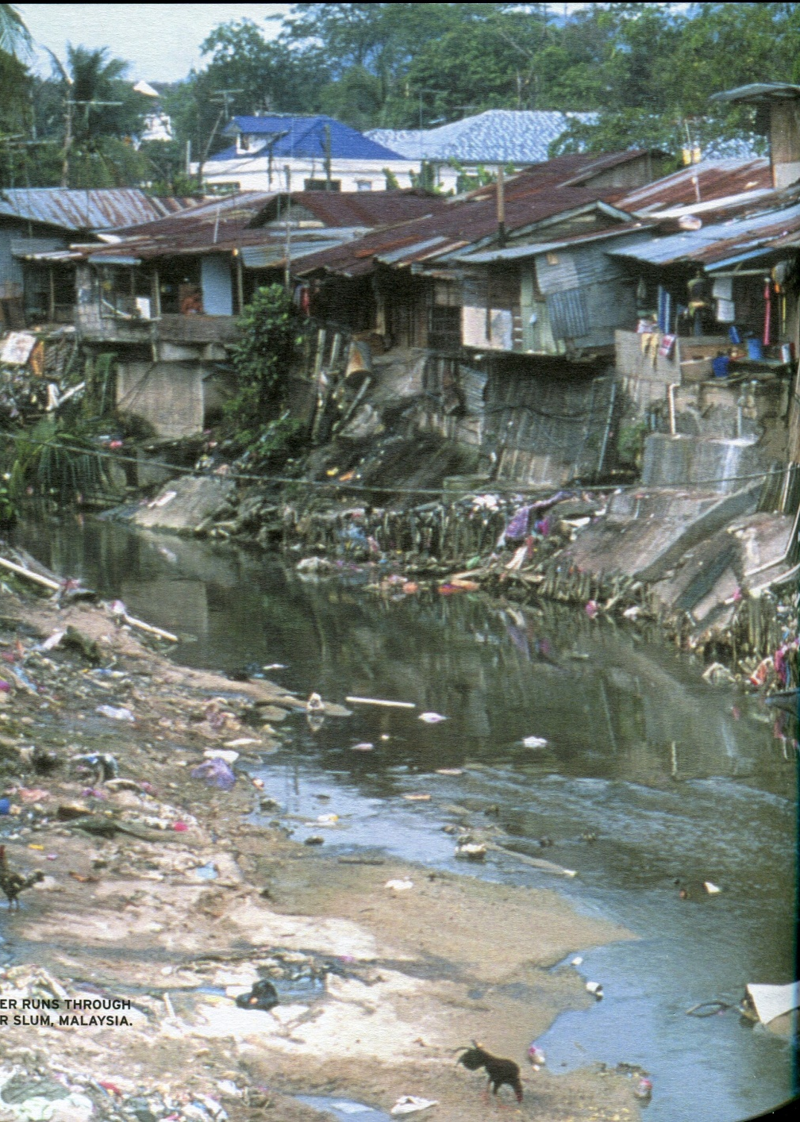
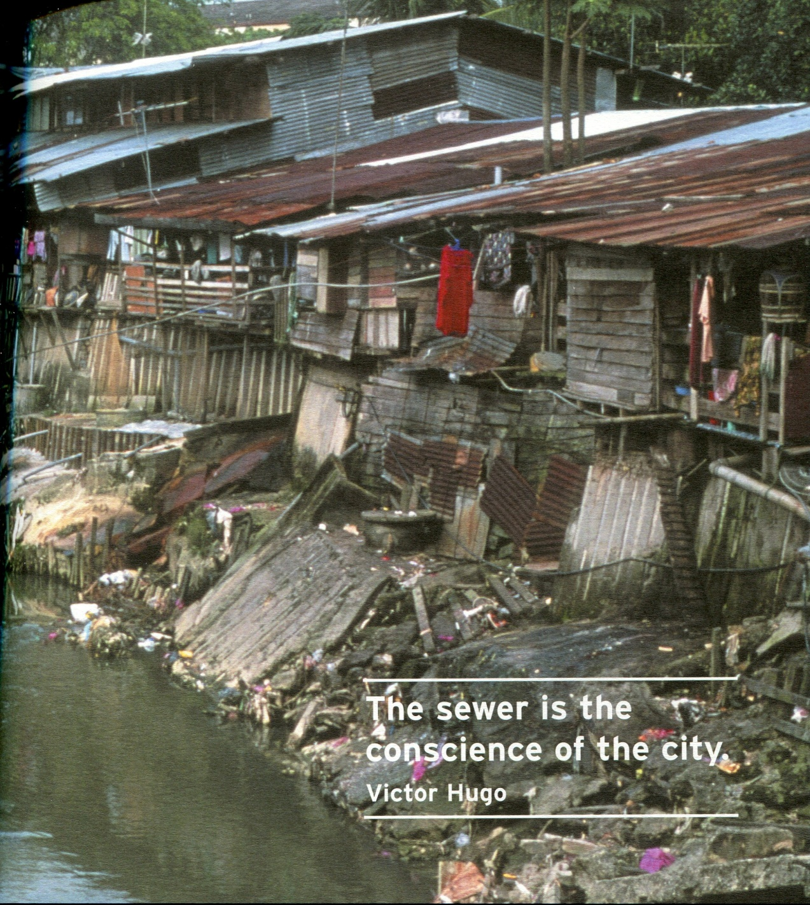
#21

Slide 24
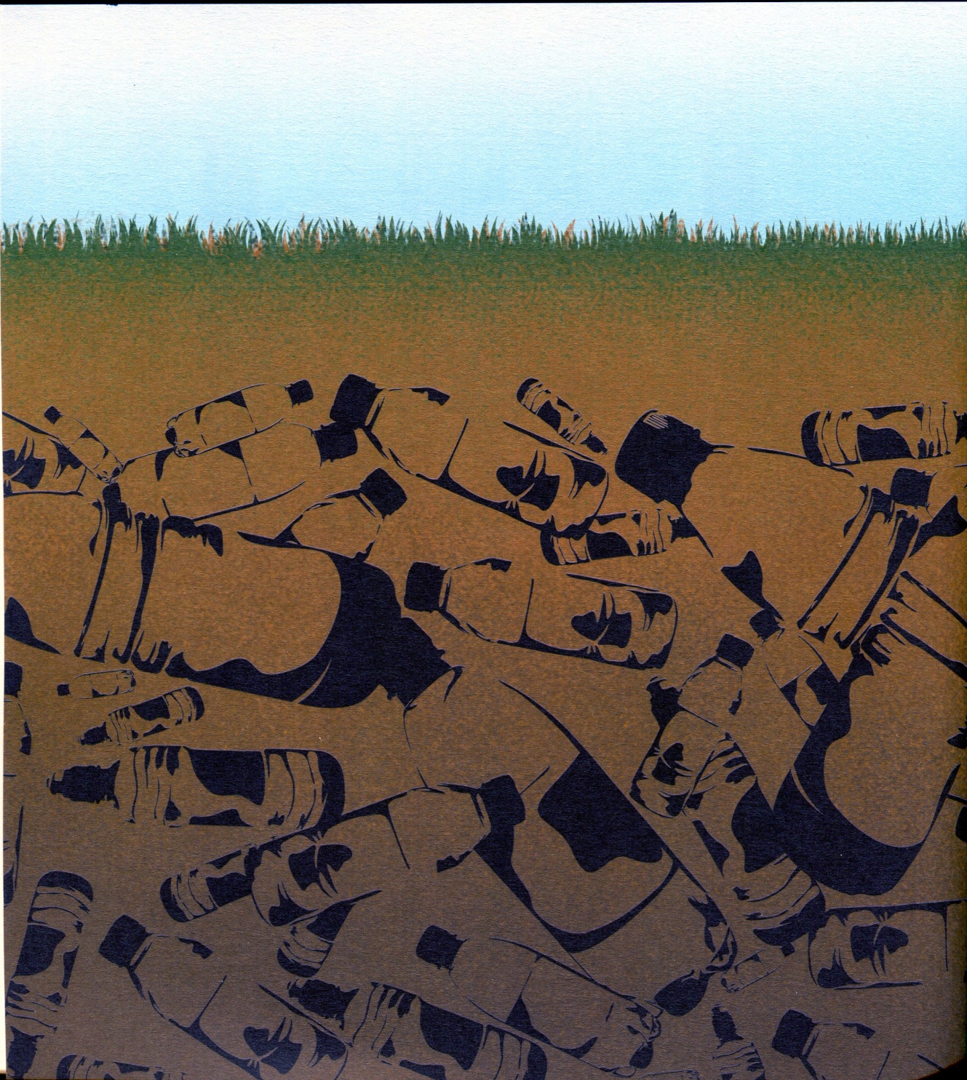
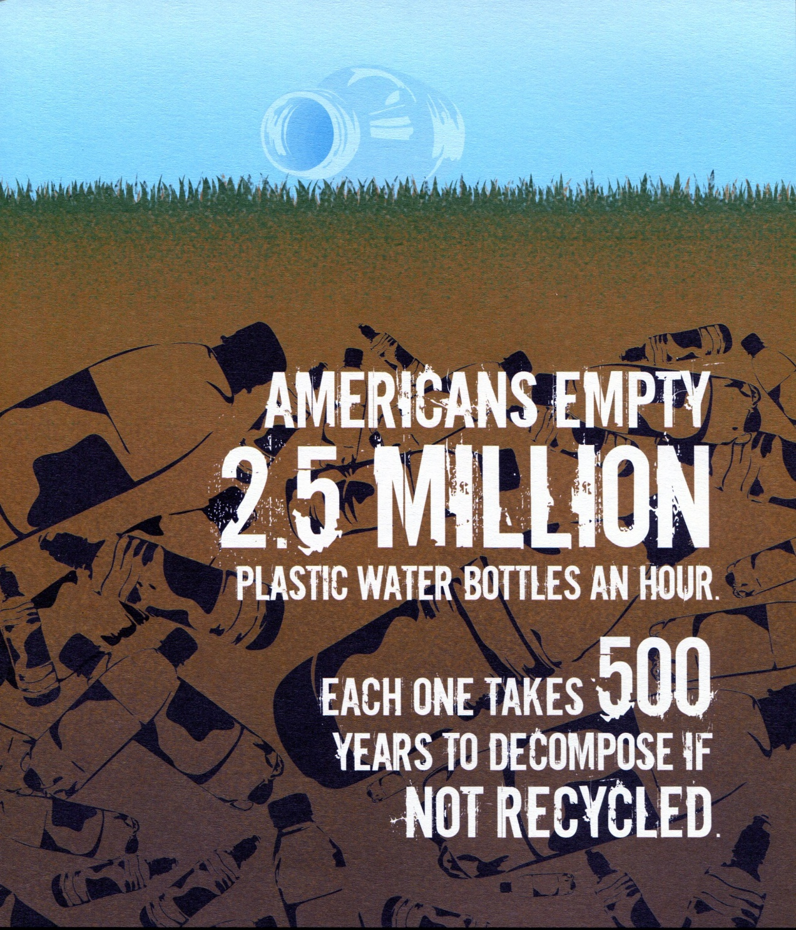
#22

Slide 25
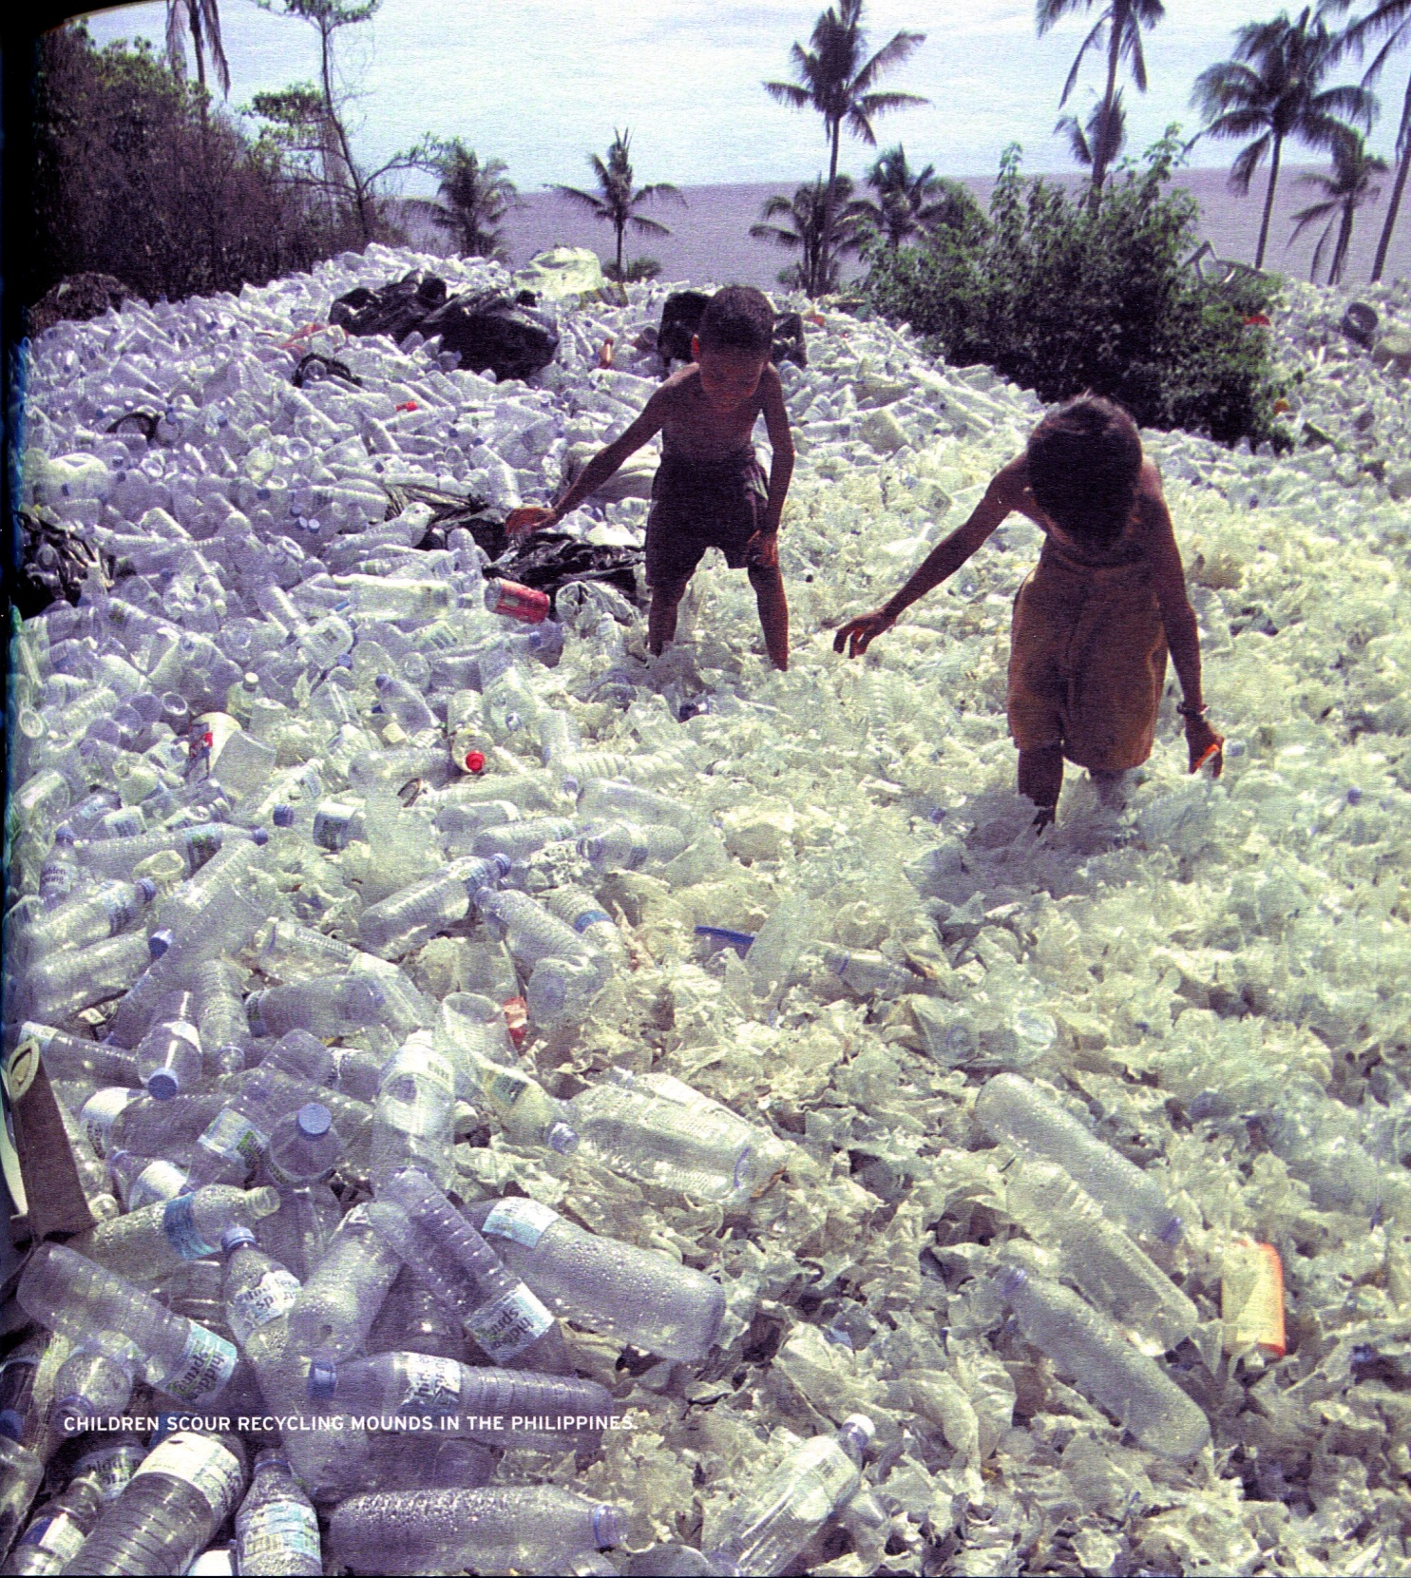
#23

Slide 26
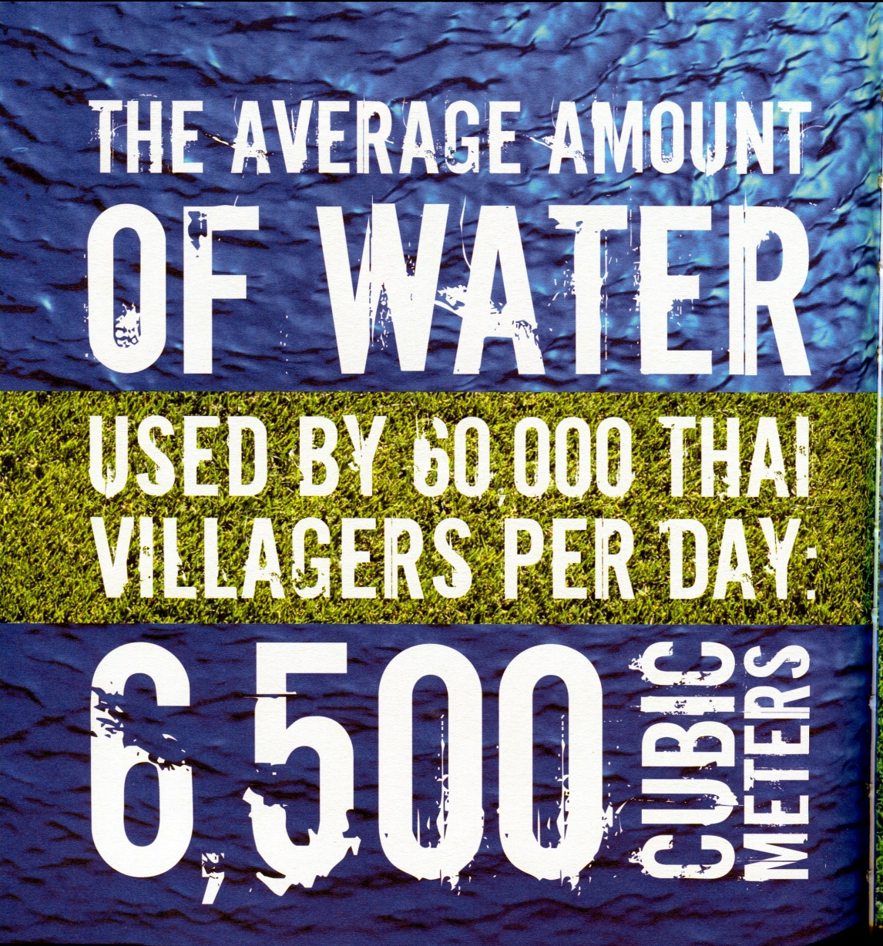
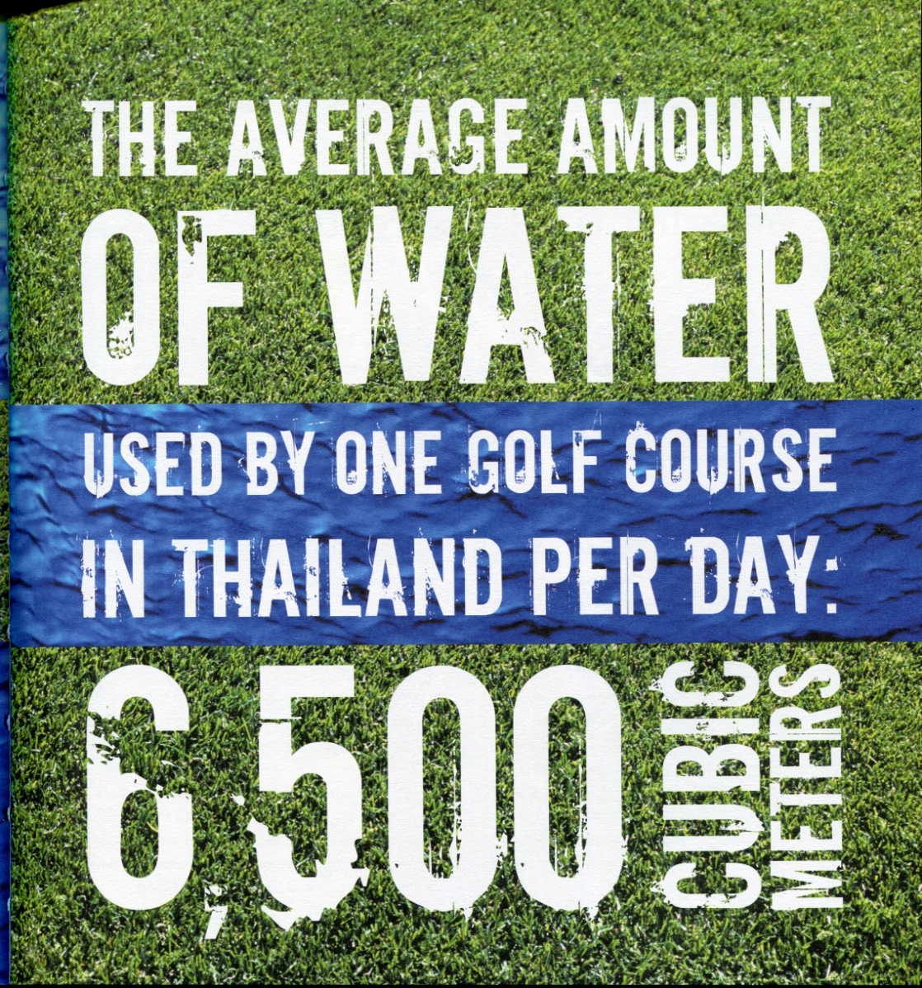
#24

Slide 27
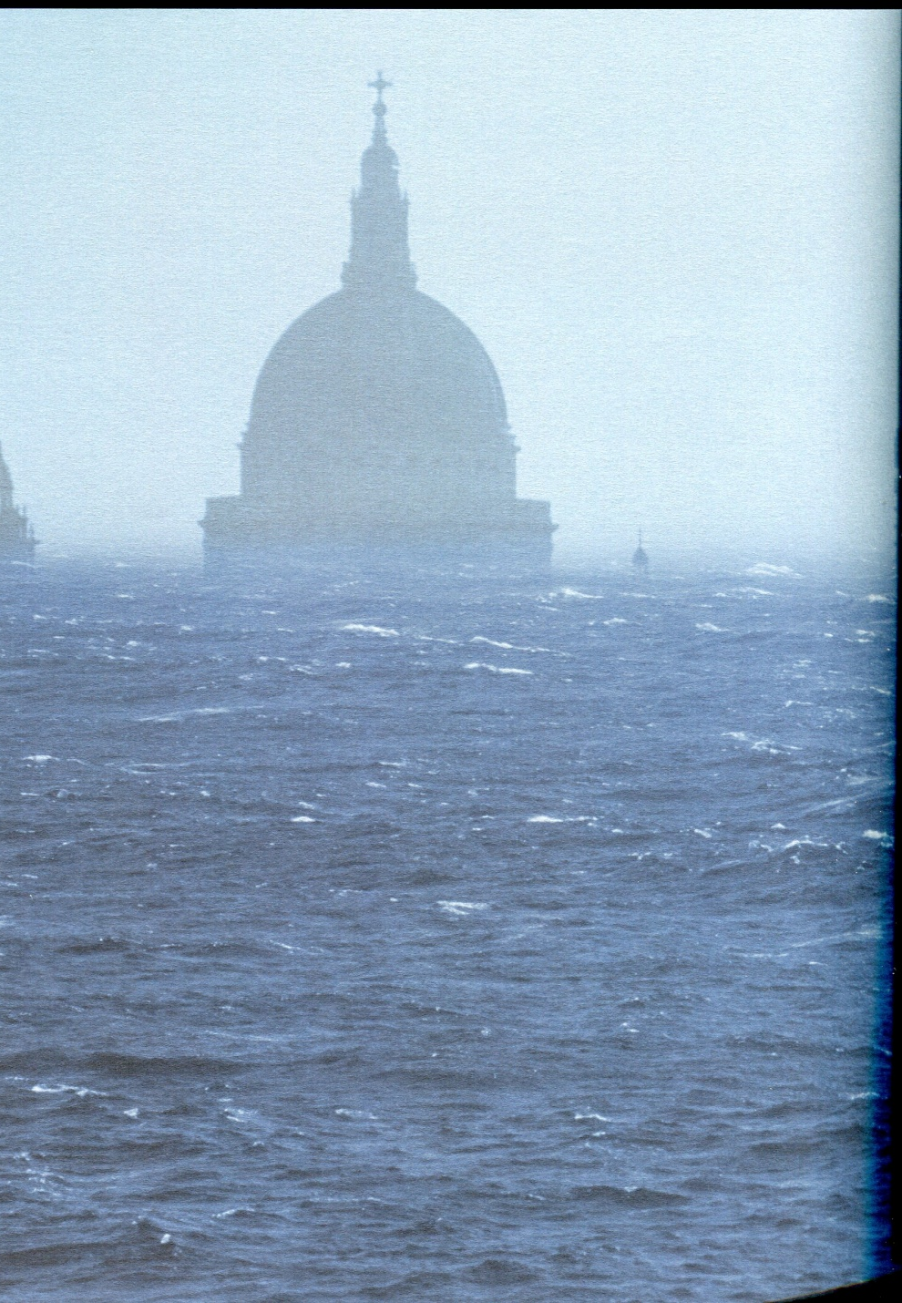
#25

Slide 28
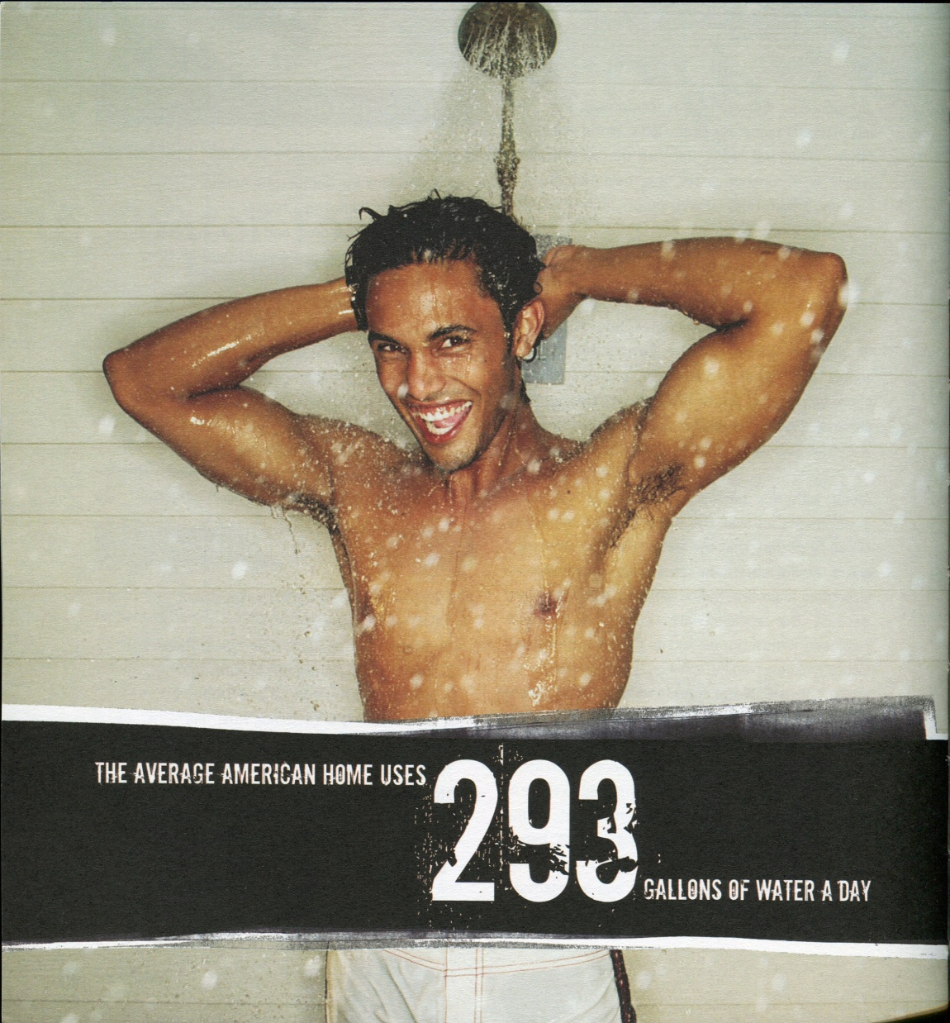
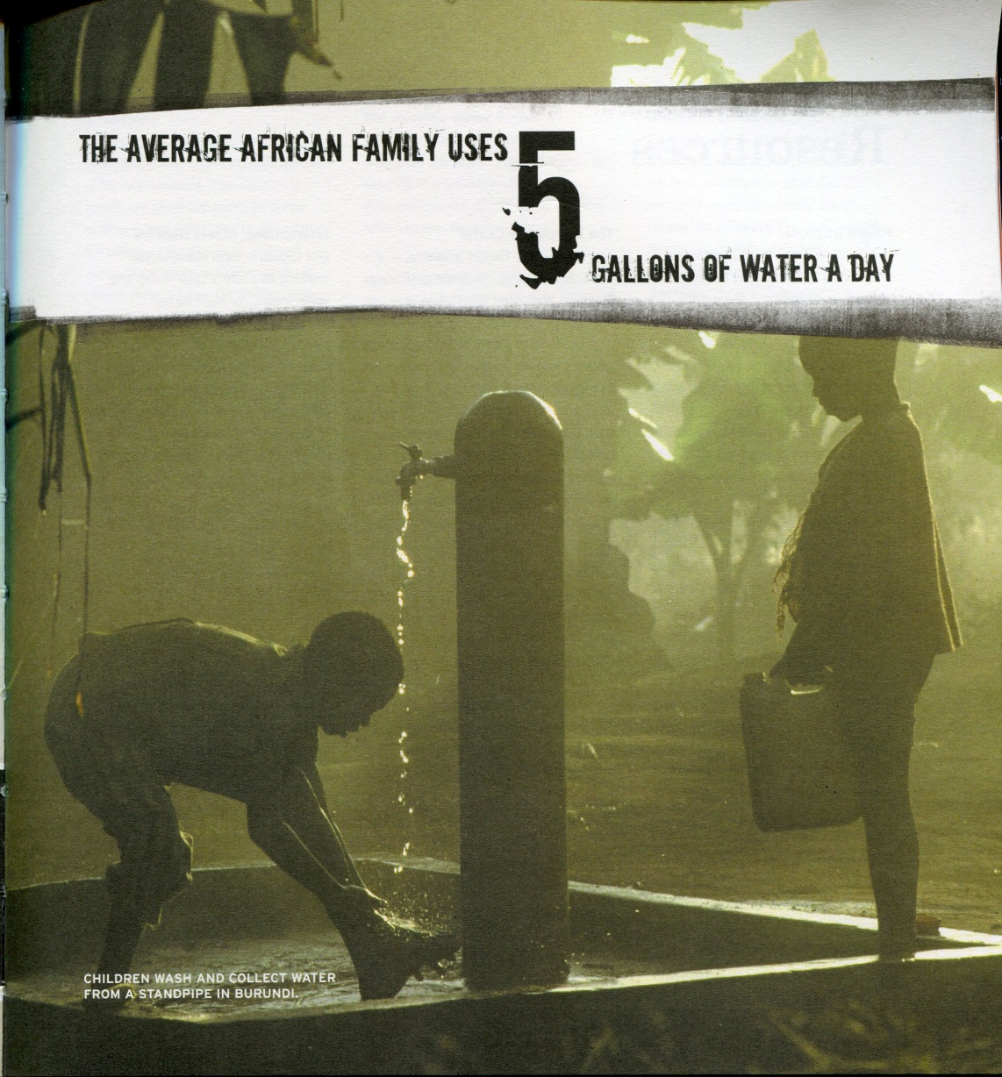
#26

Slide 29
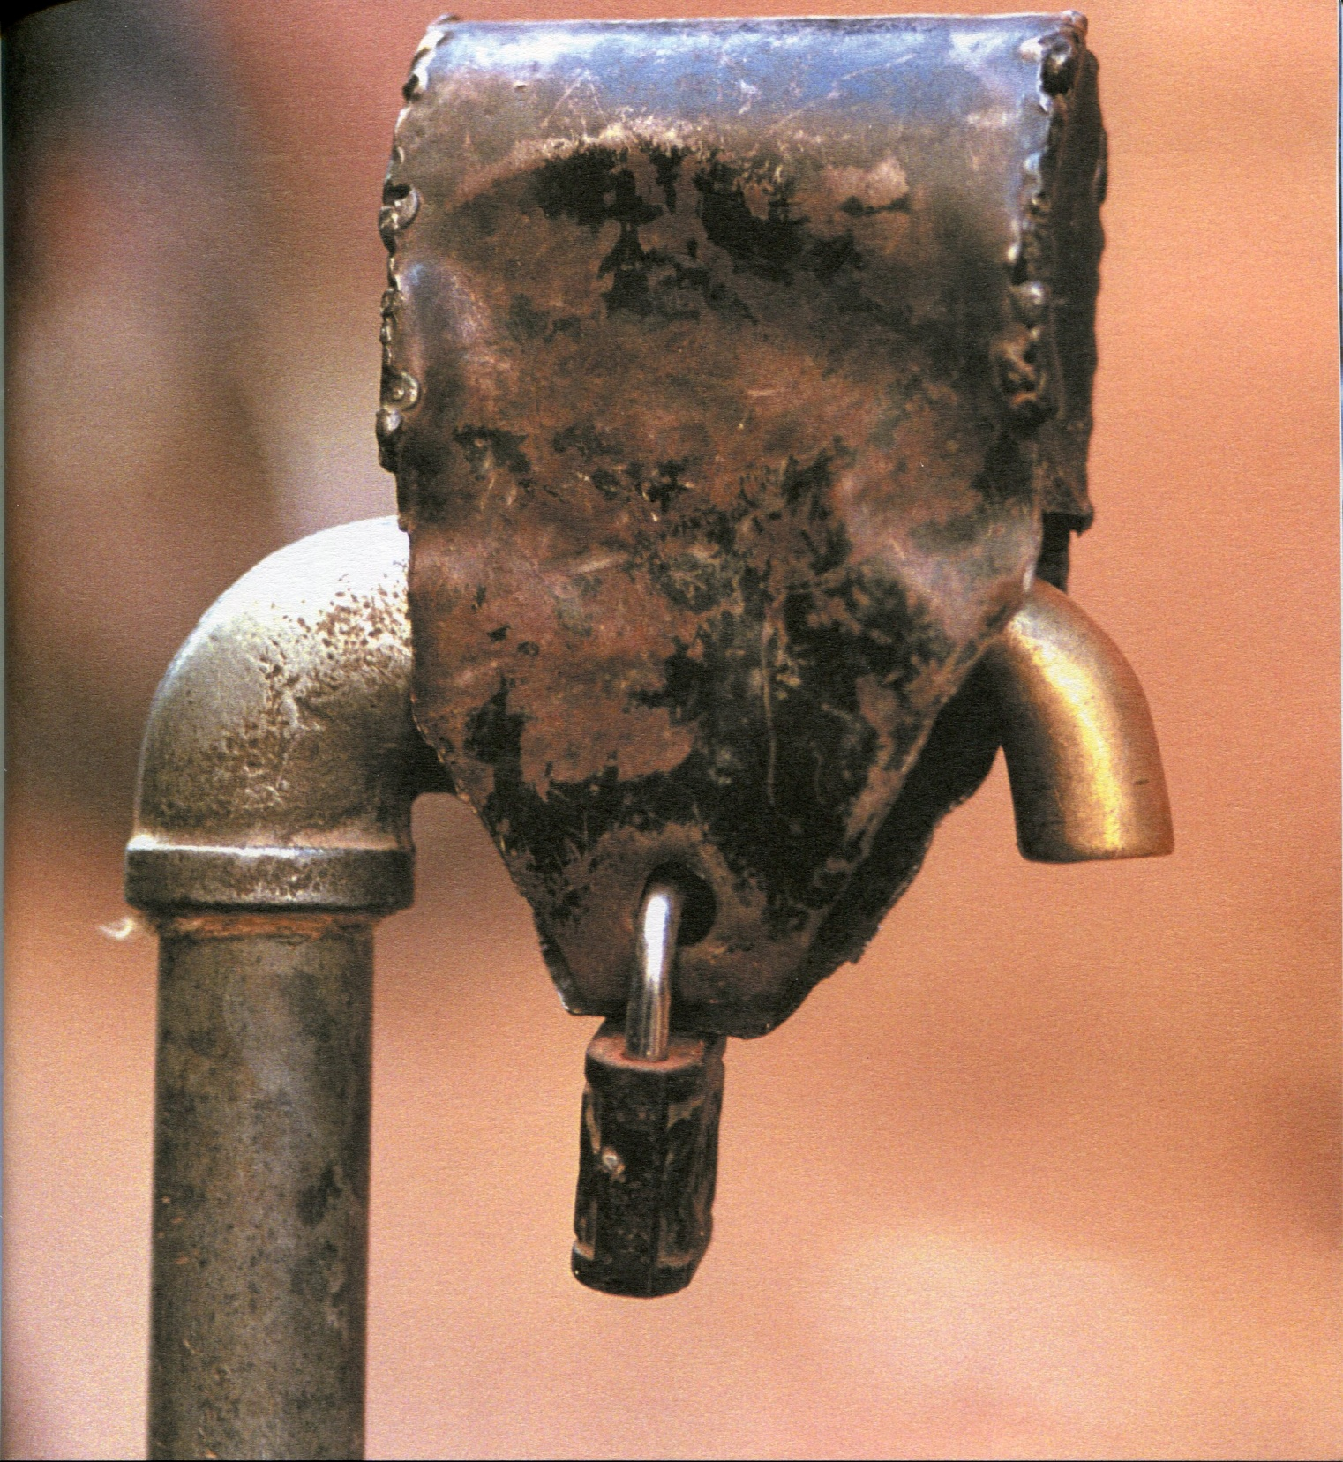
#27

Slide 30
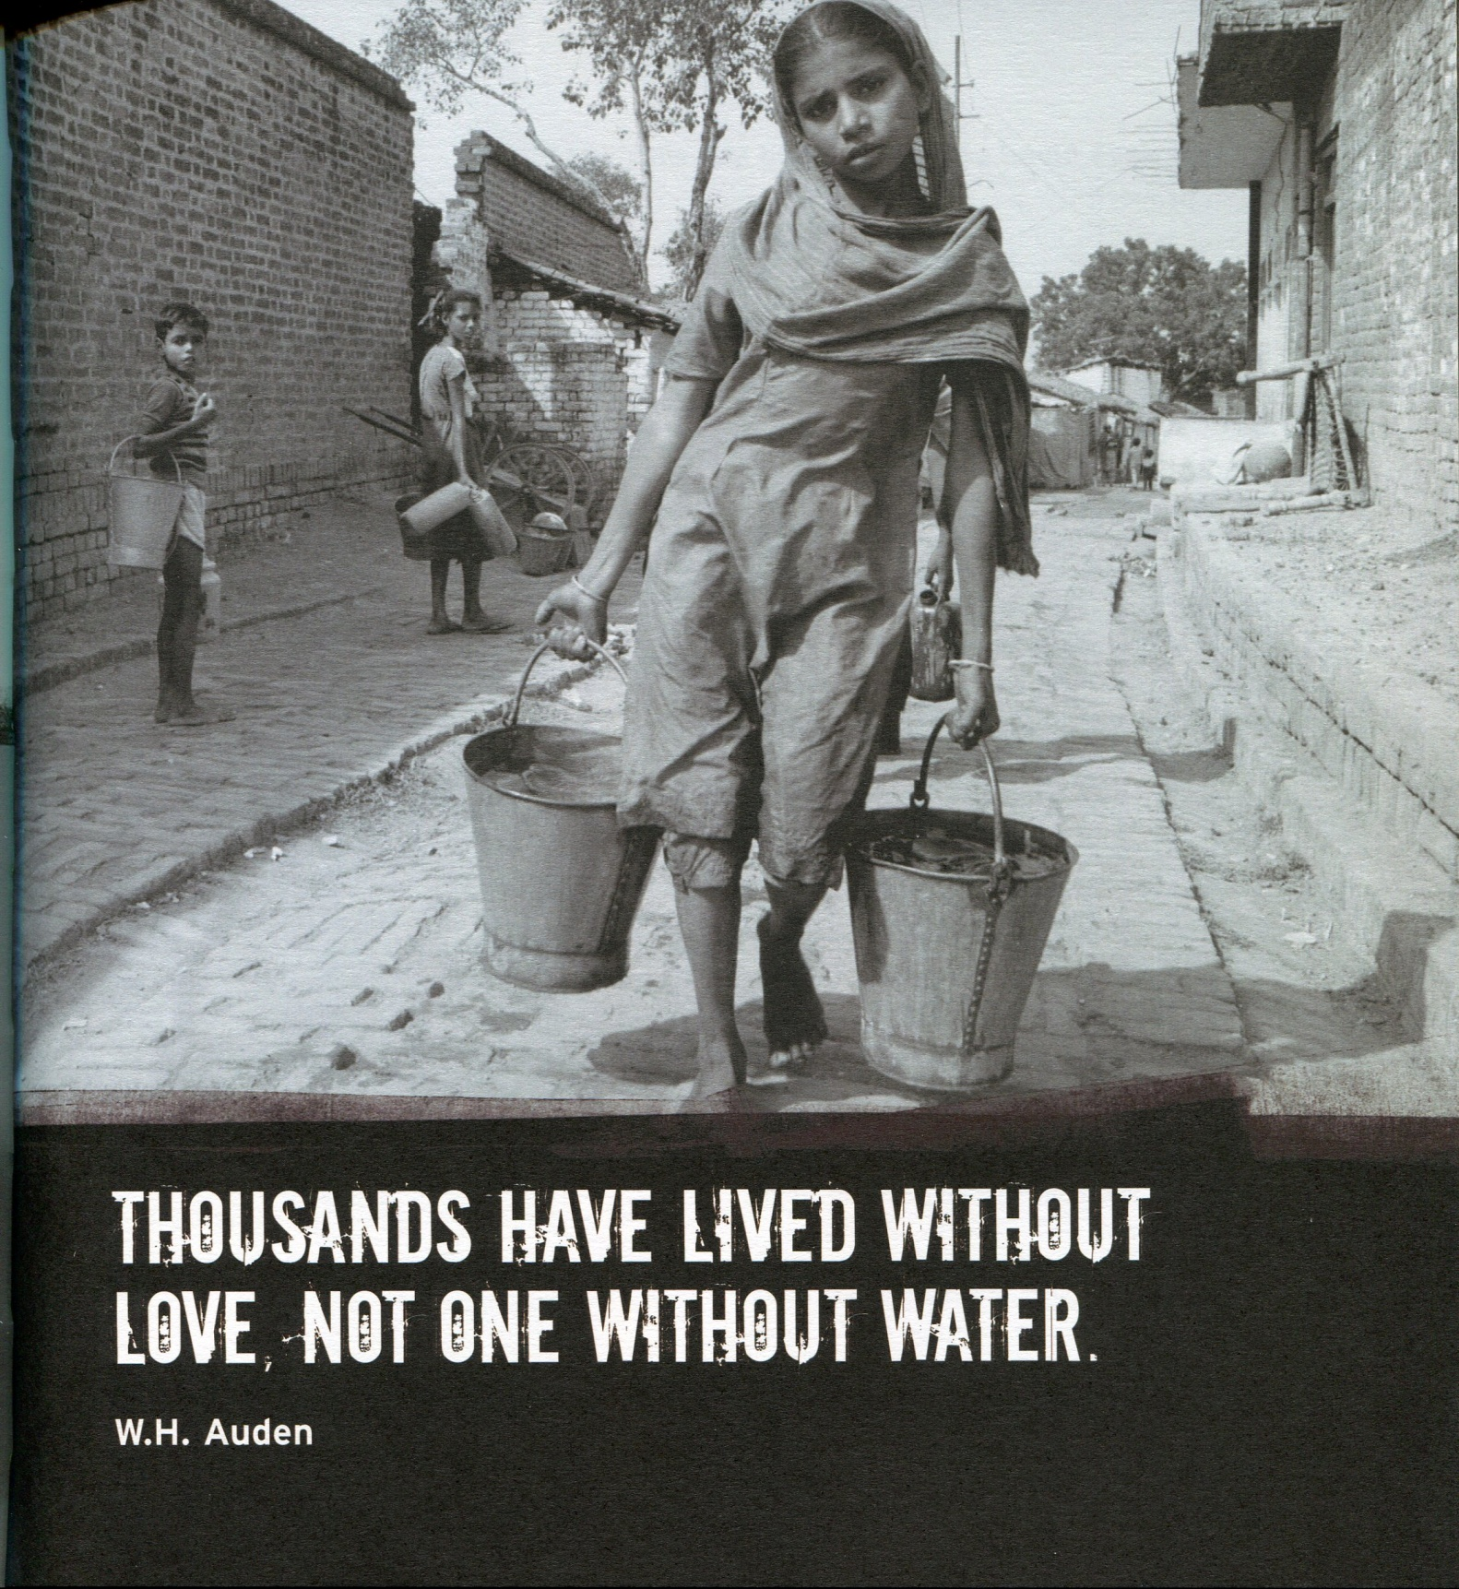
#28

Slide 31
World Water Crises (Synthesis)
What are the five most powerful ideas or slides that you saw today?
1) _______________________________________________________________________________
2) _______________________________________________________________________________
3) _______________________________________________________________________________
4) _______________________________________________________________________________
5) _______________________________________________________________________________

Slide 32
Homework Questions (Write in your notebook)
Today’s lesson was entitled “World Water Crises”. Do you think they deserve to be called crises? Give an example of a crisis (or why something’s not a crisis).
Does what you learned today change how you look at the amount of water your family uses?
Name one water crises that you think is the most severe. If we had unlimited money, how would we go about fixing it?

Slide 33
Exit Slip:
1) What was the single most powerful or interesting thing you learned today?
Homework:
World Water Crisis Questions

